Slide 1
True or false
The average teen checks their phone 150 times a day
The average adult checks their phone over 100 times a day
52% or parents and 78% of teens check their devices at least hourly
67% of parents feel their teen is addicted to their mobile phone
28% of teens say their parent is addicted to their phone
True
True
False – it’s actually 69% or parents!
False, it’s actually 59%
True

Slide 2
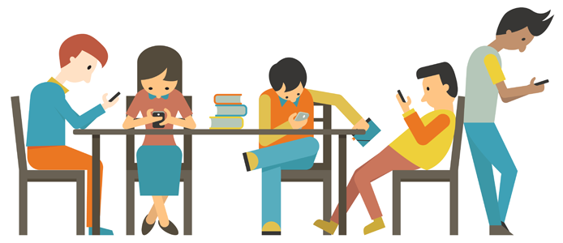
Managing Your Child’s Screen Time
Andy Compton
Assistant Head (Director of digital strategy)

Slide 3
Why do I need to manage their screen time?
Technology can have huge benefits for communication, learning and productivity, and social interactions – if used properly.
Children aged 8 to 18 spend, on average, close to 45 hours per week watching TV, playing video games, instant messaging, and listening to music online — far more time than they spend with their parents or in the classroom.
Kaiser Family Foundation
Screen time has been linked to childhood obesity, bullying, lack of concentration, sleep disturbance, access to inappropriate material, self-esteem issues and more.
So there are 2 vital elements to managing screen time:
Finding a balance that allows our children to make the most of the benefits of technology.
Educating our children so they take responsibility for their won screen time.

Slide 4
What is the biggest concern for you, regarding your child’s screen time?
TV
Games console
Laptop
Tablet
Mobile phone

Slide 5
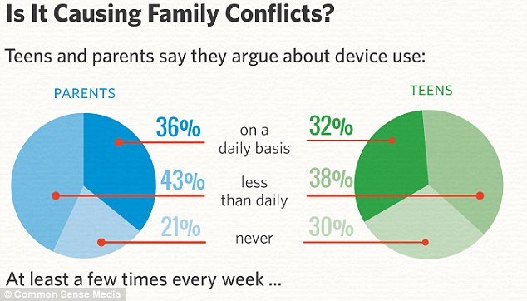
Why is it so hard to manage screen time?
Does your child do exactly as you ask when it comes to screen time?
Do they ever argue with you about the issue?
Does their phone appear to be surgically attached to them?
Do they get defensive when challenged about their screen use?
You are not the only one!
It is a common problem amongst parents, even with young children.
So why?

Slide 6
Gambling is addictive
What makes us addicted to something?
Anticipation and reward
Dopamine release
Cue: You pull the handle
Anticipation: you wait for the slots to fall into place
Reward: you get a monetary prize
Dopamine is released
A habit is formed

Slide 7
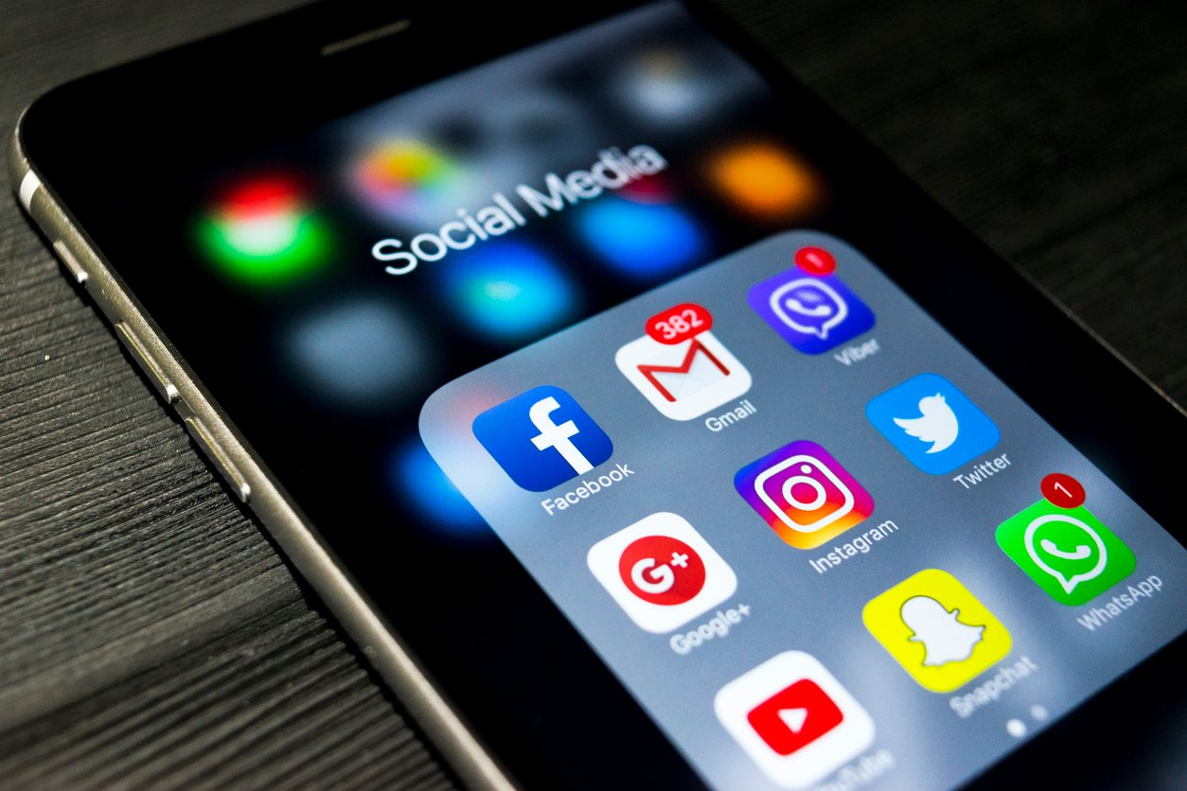
And so are mobile phones
What makes us addicted to something?
Anticipation and reward
Dopamine release
Cue: Yor phone buzzes, or you scroll down
Anticipation: you wait to see the new information
Reward: you get a like or some new information
Dopamine is released
A habit is formed

Slide 8
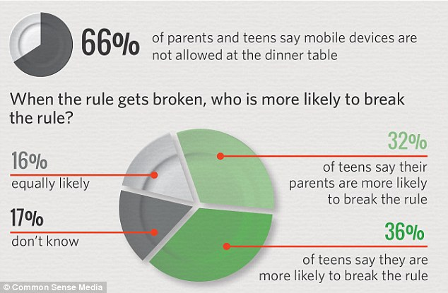
What steps can I take?
Model good practice with screen time!
Talk to your child about the benefits and dangers of technology and the effects of too much screen time.
Get screens out of the bedroom.
Keep screens off when not specifically in use, so they are not a background distraction.
Ensure screen free time for the whole family – mealtimes, homework time (unless required).
Be persistent, but fair.
Ensure both you and your child are aware of their actual amount of screen time, particularly on phones.

Slide 9
Does your child know how much they use their phone? Do you?
Find out how much you actually use it:
/
Screen Time
(iPhone)
Digital Wellbeing
(Some Android devices)
ActionDash
(Android)
Mute
Space
Moment
Family plans available
All on iPhone?
All on Android?
https://support.apple.com/en-gb/HT201304
https://support.google.com/families/answer/7103340?hl=en

Slide 10
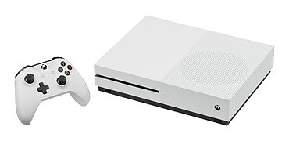
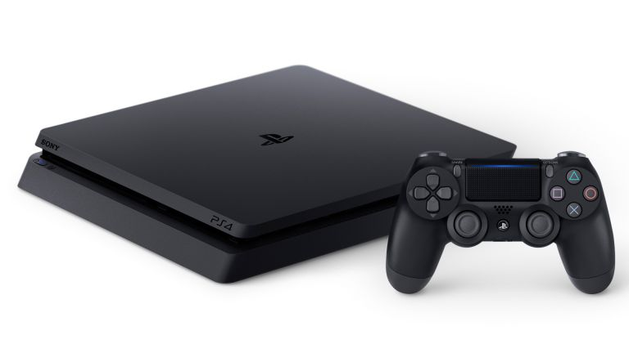
How can I manage my child’s time on the PS4/Xbox?
Both Sony and Microsoft have created management tools within the Playstation and Xbox to allow parents to setup screen time controls.
These both require you having a parent Playstation or Microsoft account which is linked to your children’s accounts, and require a bit of setup as a parent.
For full details:
PS4: https://blog.eu.playstation.com/2018/03/09/how-to-set-your-familys-ps4-play-time-using-5-50s-play-time-management/ or search ‘Managing PS4 time’
Xbox: https://www.howtogeek.com/313299/how-to-set-screen-time-limits-for-kids-on-an-xbox-one/ or search ‘managing child’s xbox time’

Slide 11
Parental Controls on your WiFi
https://www.saferinternet.org.uk/advice-centre/parents-and-carers/parental-controls-offered-your-home-internet-provider

Slide 12
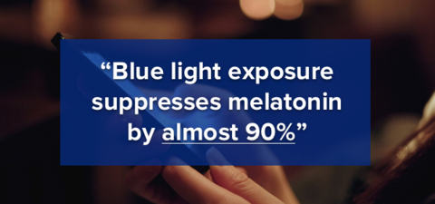
The affects of screens on sleep

